Slide 1

Analysis of Fake Currency Circulation in India
&
Detection of Fake Currency Using Statistical Image Processing and Machine Learning
Submitted By:
Shabharish
Reg. No: 2314512769

Slide 2
TABLE OF CONTENT
INTRODUCTION
RESEARCH OBJECTIVE
LITERATURE REVIEW
RESEARCH METHODOLOGY
FINDINGS AND DISCUSSIONS
CONCLUSION
RECOMMENDATIONS
LIMITATIONS
REFERENCES

Slide 3
INTRODUCTION
Counterfeit currency remains a significant threat to India’s economic stability, internal security, and public trust. The circulation of fake notes fuels inflation, aids illegal activities, and leads to financial losses across public and private sectors. With counterfeiters employing advanced printing techniques, traditional detection methods have become less effective and impractical for widespread use. This project addresses the issue through an analytical study of counterfeit currency trends across Indian states, using data from government and law enforcement sources to identify high-risk regions and inform policy decisions.
In parallel, the project presents a cost-effective, automated solution for fake note detection using image processing and machine learning. Leveraging the Banknote Authentication Dataset, key image features such as variance, skewness, kurtosis, and entropy were used to train models that accurately distinguish real from fake notes. This Python-based system offers a scalable, efficient alternative to traditional detection methods, with potential applications in banks, retail, and mobile platforms. Future enhancements could involve deep learning and real-time detection for greater accuracy and usability.

Slide 4

RESEARCH OBJECTIVES
This project aims to:
Analyze the temporal trends of counterfeit currency circulation in India over a defined time period using historical data.
The primary objective of this project is to address the growing problem of counterfeit currency circulation in India by providing both an analytical understanding of its spread and a practical technological solution for its detection. With the rise in fake notes and the limitations of traditional detection methods, there is a need for an automated, cost-effective, and scalable approach to identify counterfeit currency.
Visualize the state-wise distribution of fake currency to identify regional patterns and potential hotspots of circulation.
Develop a Python-based automated detection system that uses image processing and statistical analysis to distinguish between genuine and counterfeit currency notes.
Extract and evaluate key statistical image features such as kurtosis, skewness, entropy, and variance for effective classification of currency notes
Apply machine learning algorithms for training and testing models that accurately classify notes as genuine or counterfeit
Provide a user-friendly and portable tool, in the form of a web application, that enables individuals and institutions to verify the authenticity of currency notes quickly and efficiently

Slide 5

LITERATURE REVIEW
Sharma A (2017), in the paper "Combating Counterfeit Currency in India: Issues and Challenges," explores the complex nature of counterfeit currency as both an economic and security threat. The study analyses the systemic challenges faced by Indian authorities, including weak enforcement, gaps in cross-border monitoring, and the increasing sophistication of counterfeiters. It emphasizes the need for stronger regulatory mechanisms, inter-agency coordination, and technological upgrades in detection systems. The paper advocates for the integration of digital tools and improved public awareness as essential components in the fight against fake currency, aligning well with modern data-driven and AI-based detection approaches.
Sharma and Sharma P (2018), in their study "An Overview of Counterfeit Currency in India," highlight the growing threat of fake currency and its impact on the Indian economy. They discuss how counterfeit money supports illegal activities like terrorism and smuggling, and how advancements in printing technology have made detection more challenging. The paper emphasizes the roles of the RBI, law enforcement, and public awareness in combating this issue. It concludes by recommending a multi-pronged strategy involving technology, enforcement, and education – supporting the use of modern tools like image processing and machine learning for effective counterfeit detection.
Aakash S. Patel et al. focused on applying machine learning algorithms in the field of image processing for fake currency detection. Their approach involved training the system using a pre-compiled dataset containing images of both genuine and counterfeit currency notes. The algorithm analyses this dataset to extract key features, enabling the system to accurately classify new input images of similar format as either real or fake

Slide 6


RESEARCH
METHODOLOGY
This project adopts a two-phase approach to tackle the issue of counterfeit currency in India, combining data analysis with machine learning-based detection. The first phase involves studying the trends and regional patterns of fake currency circulation using government and law enforcement data, while the second phase focuses on developing an automated detection system using image processing and machine learning techniques. Together, these phases aim to provide both strategic insights for policy intervention and a practical tool for real-time counterfeit note detection, making the solution holistic and impactful.

Slide 7

In the first phase, data was collected using the secondary data collection method from reliable sources such as the Reserve Bank of India (RBI), National Crime Records Bureau (NCRB), and government reports. This data included annual counts, denominations, and the geographical distribution of seized counterfeit notes. After cleaning and standardizing the data, exploratory data analysis (EDA) was conducted to identify trends and regional hotspots. Visual tools like Tableau and IBM Cognos were used to present the findings through heat maps, line graphs, and tree maps. The analysis revealed key insights, such as frequent counterfeit activity in states like Delhi and Gujarat and seizure spikes around national events like demonetization.
ANALYSIS OF FAKE CURRENCY CIRCULATION IN INDIA

Slide 8

The second phase focused on building a low-cost, automated fake currency detection system using the Banknote Authentication Dataset. Image processing techniques were applied to extract statistical features like variance, skewness, kurtosis, and entropy from note images. These features were used to train various machine learning models, with the dataset split into 70% training and 30% testing sets. The best-performing model was integrated into a Python-based application that enables users to upload note images or input features to verify authenticity in real-time. However, since the dataset was last updated in 2012, the system currently cannot detect newer currency designs, which can be addressed in future iterations with updated data.
DETECTION OF FAKE CURRENCY USING IMAGE PROCESSING AND MACHINE LEARNING

Slide 9
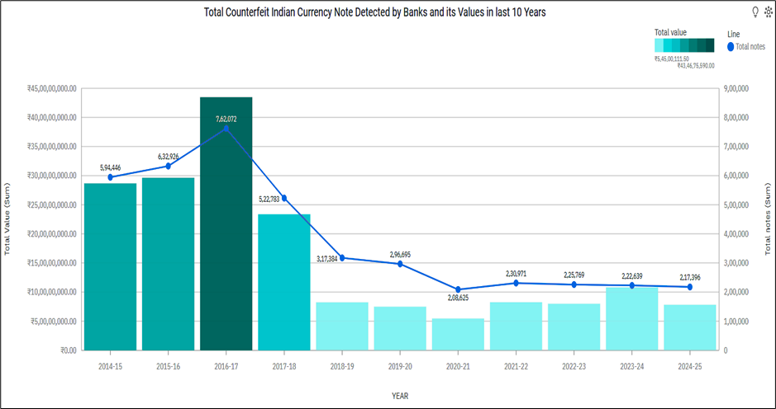
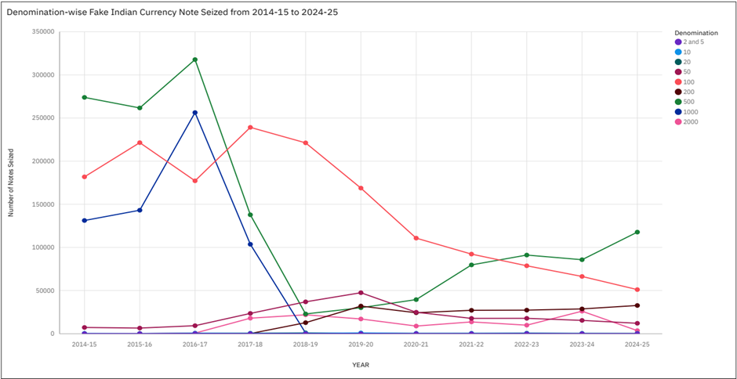
FINDINGS AND DISCUSSIONS
The analysis of counterfeit currency circulation in India from FY2014–15 to FY2024–25 highlights key trends, including a major spike in FY2016–17 with over 7.6 lakh fake notes worth ₹43 crore seized, primarily due to fake ₹500 and ₹1000 notes before demonetization. While demonetization led to a temporary decline, counterfeiters soon shifted to new denominations like ₹200 and ₹2000, with fake ₹2000 notes rising until FY2023–24 and then dropping sharply after their withdrawal in FY2024–25. ₹100 notes remained among the most frequently counterfeited due to their widespread use, while lower denominations saw minimal forgery. Notably, commercial banks were responsible for detecting over 95% of fake notes, highlighting their critical role in identifying counterfeits.

Slide 10
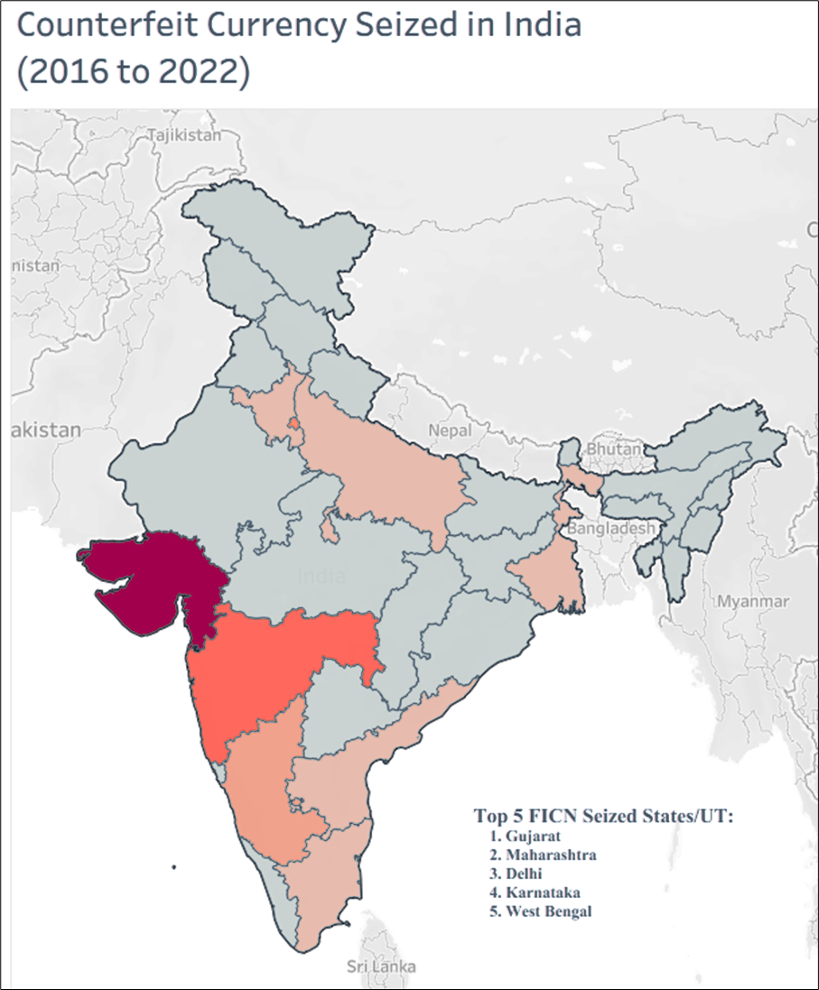
FINDINGS AND DISCUSSIONS
Between 2016 and 2022, Gujarat recorded the highest counterfeit currency seizure value at ₹355.16 crore, significantly surpassing other states like Maharashtra, Delhi, Karnataka, and West Bengal. A major spike occurred in 2022, with national seizures reaching ₹3,826 crore - around 65% of the seven - year total - largely due to Gujarat’s unusually high figures, possibly linked to stronger enforcement or the busting of a major counterfeit network. Geographic visualizations showed that counterfeit activity was concentrated in economically active and border states like West Bengal, Punjab, and Assam, likely due to cross-border smuggling, while smaller states and UTs reported minimal cases. Delhi stood out with over ₹37 crore in seizures, underlining its strategic role in counterfeit circulation.

Slide 11
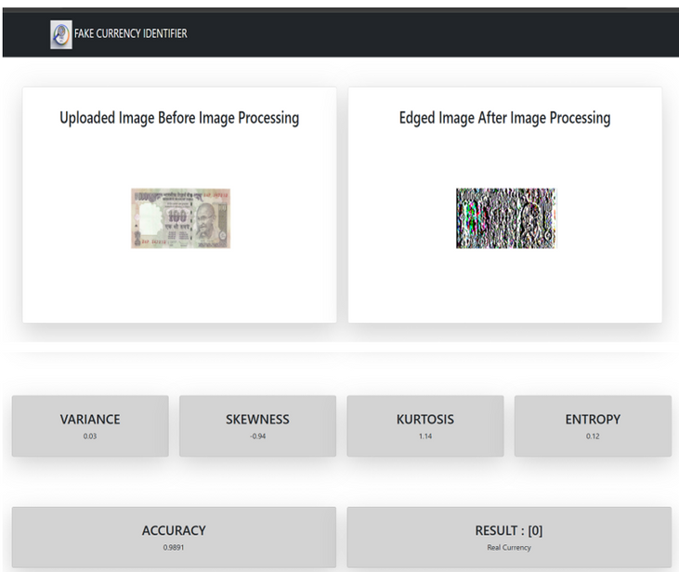
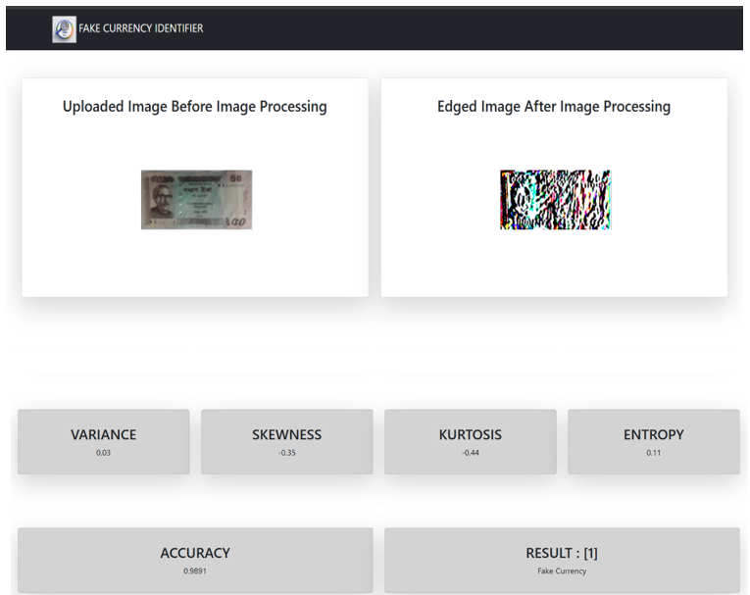
FINDINGS AND DISCUSSIONS
The fake currency detection system developed in Phase II utilized image processing and machine learning techniques to accurately differentiate between real and counterfeit banknotes. Key statistical features such as variance, skewness, kurtosis, and entropy were extracted from scanned note images. Enhanced edge detection helped highlight subtle differences in texture and patterns, which are crucial for effective classification.
Analysis of sample notes showed that counterfeit notes typically had low kurtosis and negative skewness, reflecting less detail and irregular image data, while genuine notes exhibited higher kurtosis and more symmetrical distributions. For example, a fake note showed -0.44 kurtosis and -0.35 skewness, while a real note had 1.14 kurtosis and -0.94 skewness, along with a slightly higher entropy value, indicating richer information content.

Slide 12

FINDINGS AND DISCUSSIONS
The counterfeit currency detection system achieved a high accuracy of 98.91%, meaning it correctly identified real and fake notes in nearly 99 out of 100 cases. This strong performance indicates that the machine learning model is highly reliable in distinguishing between genuine and counterfeit banknotes based on extracted image features such as variance, skewness, kurtosis, and entropy.
The system processes images in real-time, making it fast and efficient for practical use. Its user-friendly interface and low-cost setup make it ideal for integration in various everyday environments like ATMs, point-of-sale (POS) machines, and automated kiosks—where quick and accurate currency authentication is essential.
Overall, the results validate that combining image processing (for extracting important visual features) with machine learning (for intelligent classification) can deliver an effective, scalable, and affordable solution to combat the growing issue of counterfeit currency in India.

Slide 13
CONCLUSIONS
This project provides a comprehensive approach to tackling counterfeit currency in India by combining analytical research with technological innovation. The first phase highlights how the circulation of Fake Indian Currency Notes (FICN) is influenced by policy changes, regional enforcement, and geographic vulnerabilities, with demonetization offering only a temporary deterrent. State-wise disparities in counterfeit detection point to uneven enforcement and potential smuggling routes, emphasizing the need for improved coordination and infrastructure. The second phase demonstrates the successful development of a cost-effective, Python-based fake currency detection system using image processing and machine learning, achieving a high accuracy of 98.91%. By extracting key statistical features from note images, the system offers a practical, scalable solution suitable for real-time deployment in banks, retail environments, and public services. Together, both phases present actionable insights and a reliable technological tool to support national efforts in combating counterfeit currency circulation.

Slide 14
RECOMMENDATIONS
Strengthen Currency Design and Security: Periodic updates to currency security features can help stay ahead of counterfeiters, especially for high-circulation denominations like ₹100 and ₹500.
Encourage Inter-agency Collaboration: Improve coordination between the RBI, law enforcement, and intelligence agencies for faster detection, tracking, and dismantling of counterfeit networks.
Establish Specialized Anti-Counterfeit Units:
Set up dedicated task forces in states with high FICN activity for targeted operations and quicker response.
Increase Awareness Among the Public:
Launch nationwide campaigns to educate people about identifying fake notes through visible security features.
Improve Cross-border Surveillance: Deploy more resources at international borders to detect smuggling routes, especially in states like West Bengal, Punjab, and Assam.
Enhance Detection Technology at Banks:
Invest in advanced currency sorting and scanning systems at commercial banks to improve detection rates.

Slide 15

RECOMMENDATIONS
Real-time Implementation: Optimize the algorithm for real-time deployment on edge devices (e.g., Raspberry Pi, embedded systems), enabling the system to be used in fast-paced environments such as retail counters or cash deposit machines
Expanding Dataset: Expand the dataset to include a wider variety of banknotes, counterfeit techniques, lighting conditions, and printing styles. Collaborate with financial institutions and government bodies for access to real-time and authentic data samples.
Cross-validation and Pilot Testing:
Conduct pilot testing in partnership with banks or cash-intensive sectors to validate the system's performance under real-world conditions and refine it based on user feedback
Enhancing Dataset: As the current model is trained on pre-2012 data, it is essential to retrain and fine-tune the algorithm using updated datasets that include recent Indian currency notes, especially the new ₹500 and ₹2000 denominations, to ensure continued relevance and accuracy

Slide 16
LIMITATIONS
The first phase relies entirely on secondary data from credible sources such as the Reserve Bank of India (RBI) and the National Crime Records Bureau (NCRB). While informative, these sources may not capture unreported or undetected cases of counterfeit currency. Additionally, inconsistencies in data reporting standards across states and the absence of real-time data limit the accuracy and comparability of the findings.
The second phase used a dataset based on pre-2012 currency notes, reducing the model’s effectiveness in identifying newer denominations like the updated ₹500 and ₹2000 notes. The machine learning system was built using basic algorithms, and more advanced models like Convolutional Neural Networks (CNNs) could offer better accuracy, especially for complex or low-quality images. The dataset from OpenML and Kaggle may not fully represent current counterfeiting techniques, affecting real-world performance.
Time limitations impacted both phases, preventing primary data collection through field surveys or expert interviews. As a result, the study lacks qualitative insights from enforcement personnel and banking professionals, which could have added depth and validated the findings from a practical perspective.

Slide 17

REFERENCES
National Crime Record Bureau: ‘Crime in India’ publication. https://www.ncrb.gov.in/crime-in-india.html
Reserve Bank of India (RBI). (2021). “Detection and Reporting of Counterfeit Notes.” Retrieved from https://www.rbi.org.in/Scripts/BS_ViewMasDirections.aspx?id=10473
https://www.data.gov.in/resource/denomination-wise-data-regarding-annual-percentage-increase-fake-currency-notes
Reserve Bank of India - Annual Report . https://rbi.org.in/scripts/AnnualReportPublications.aspx?Id=1438
OpenML. https://www.openml.org/data/download/1586223/php50jXam
https://archive.ics.uci.edu/dataset/267/banknote+authentication
National Crime Record Bureau: ‘Crime in India’ publication. https://www.ncrb.gov.in/crime-in-india.html

Slide 18
Thank You

